Slide 1

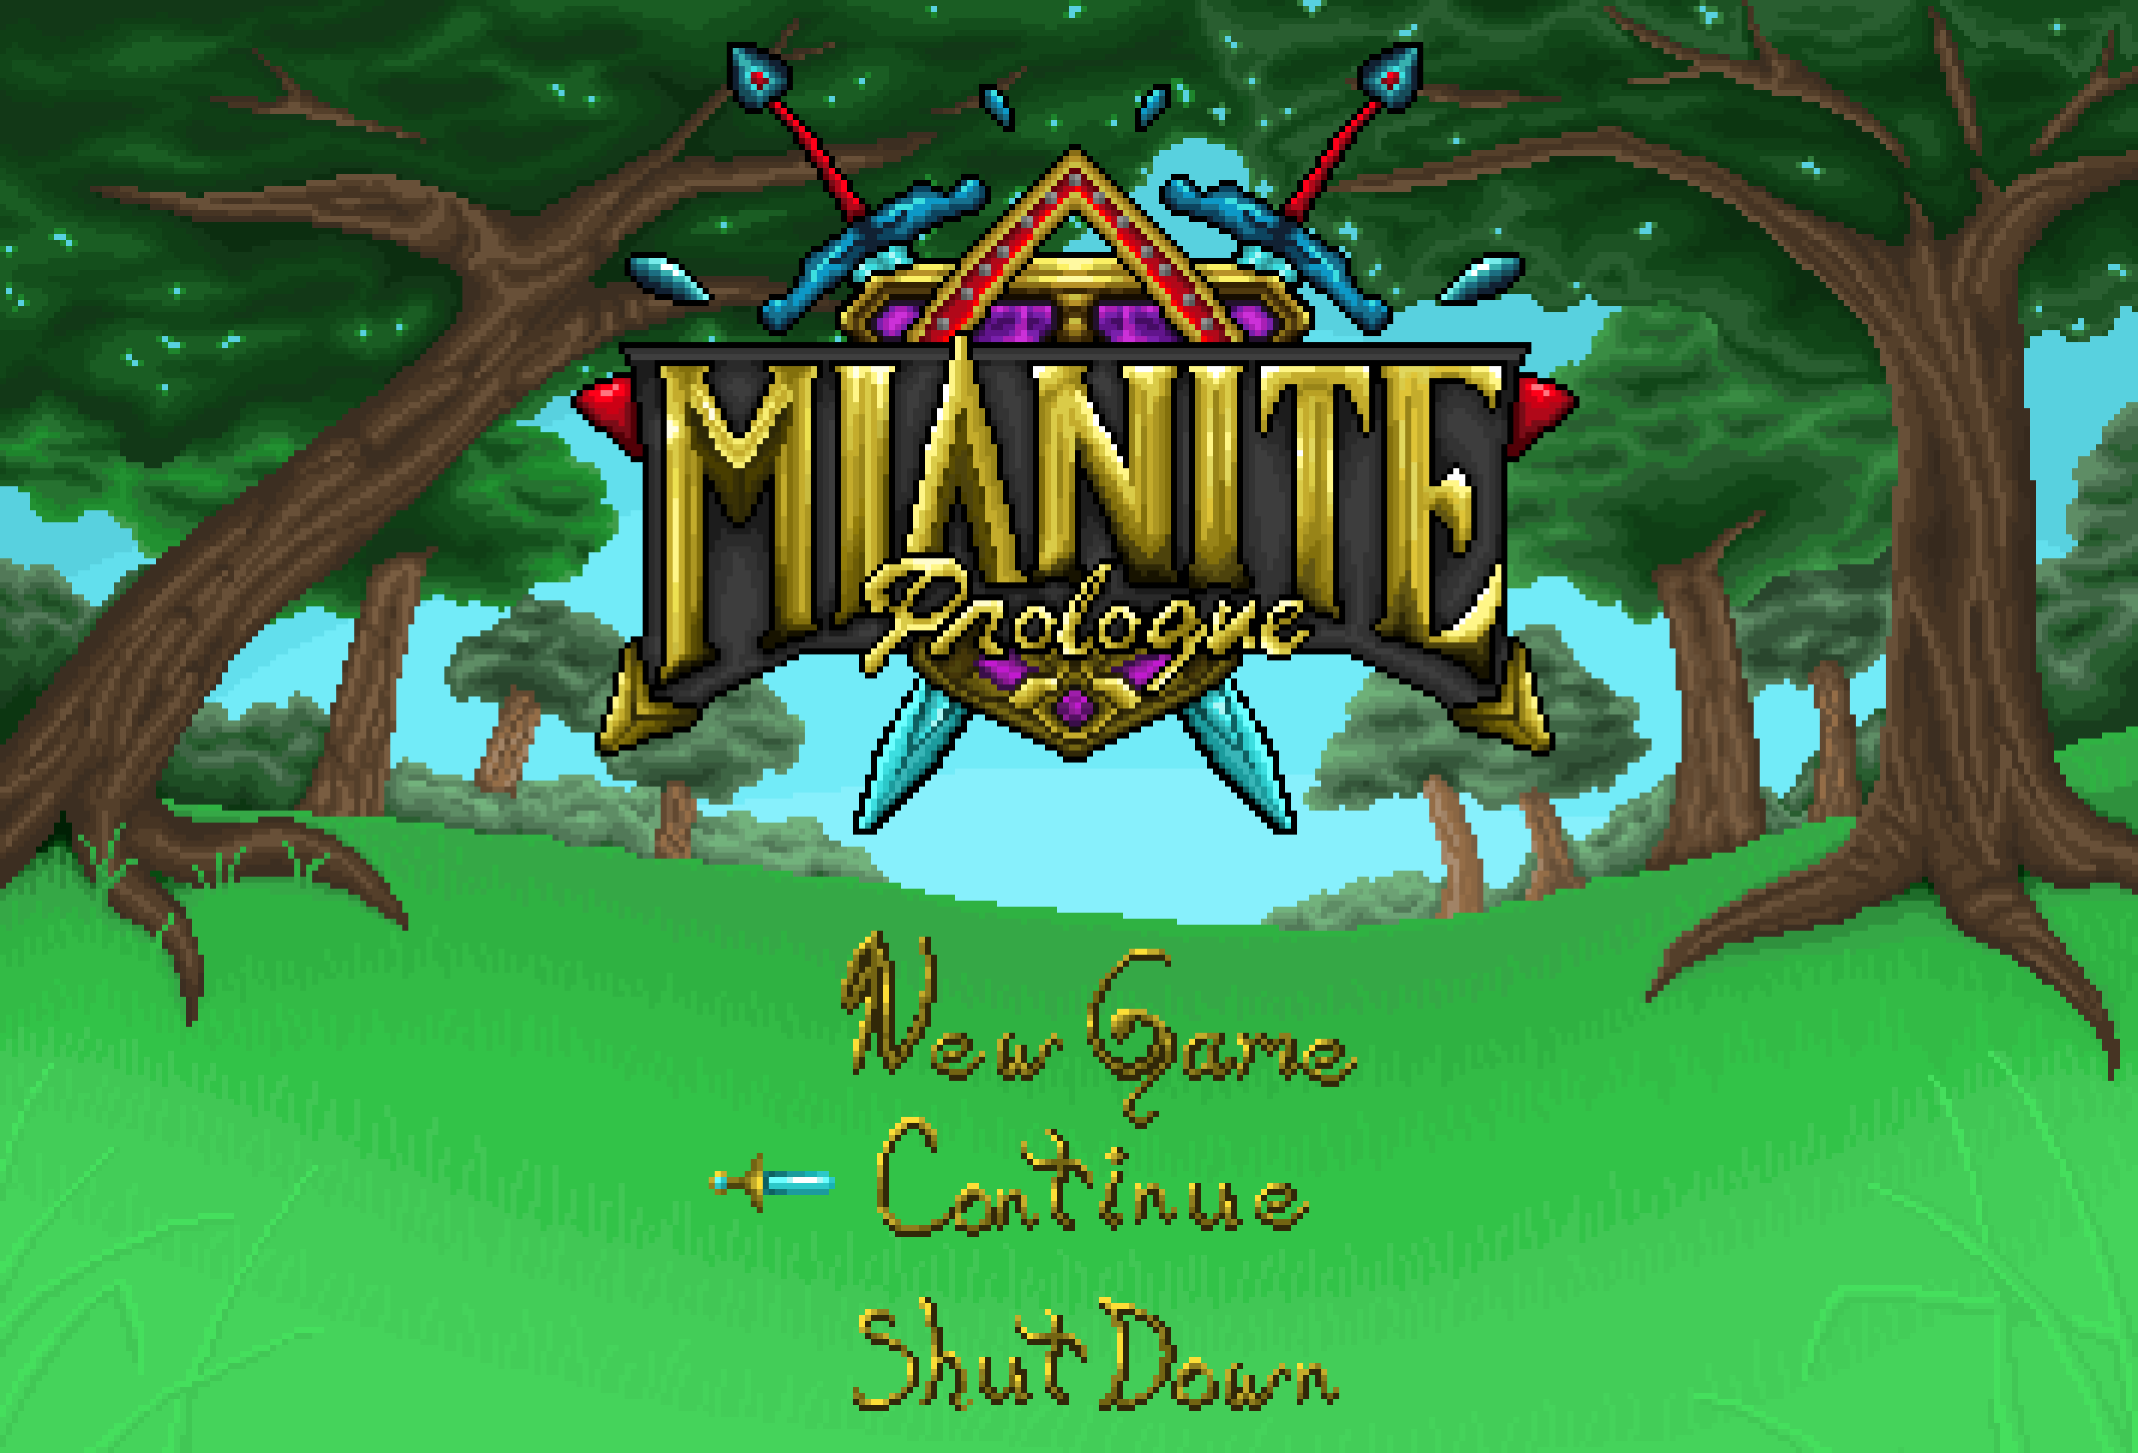
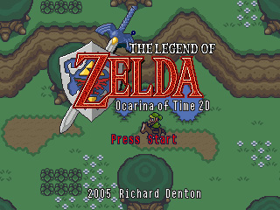

Slide 2
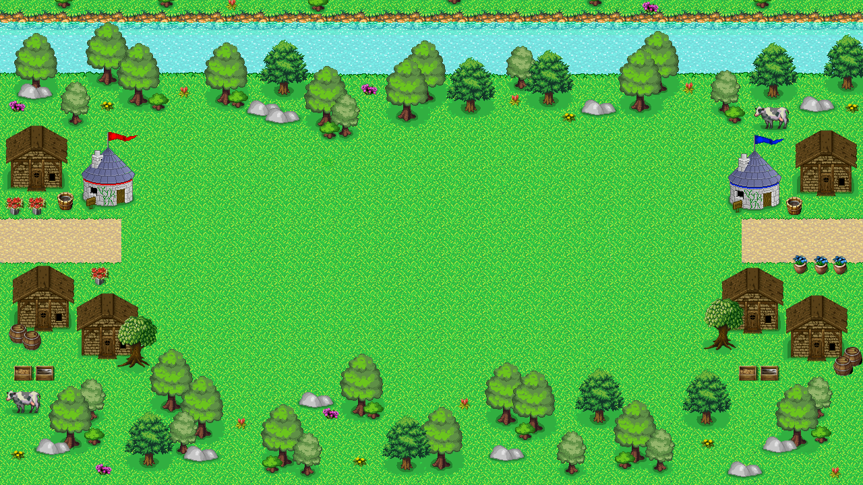





Slide 3


Slide 4


Slide 5


Slide 7



Slide 9



Slide 10







Slide 11



Slide 12




Slide 14


Slide 15
Pointless Wars
Pointless Wars

Slide 16


Pointless Wars
Pointless Wars

Slide 17
Pointless Wars
Pointless Wars
Pointless Wars

Slide 18
Pointless Wars
Pointless Wars

Slide 19

Pointless Wars
Pointless Wars

Slide 20
Pointless Wars
Pointless Wars

Slide 21
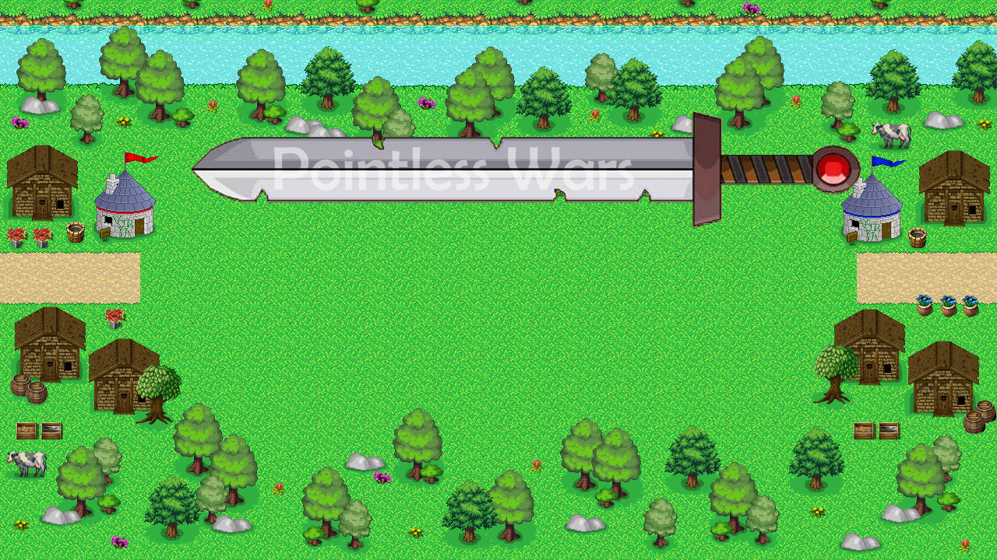

Slide 22
Pointless Wars
Pointless Wars

Slide 23

Pointless Wars
Pointless Wars

Slide 24
Pointless Wars
Pointless Wars

Slide 25
Pointless Wars
Pointless Wars

Slide 26
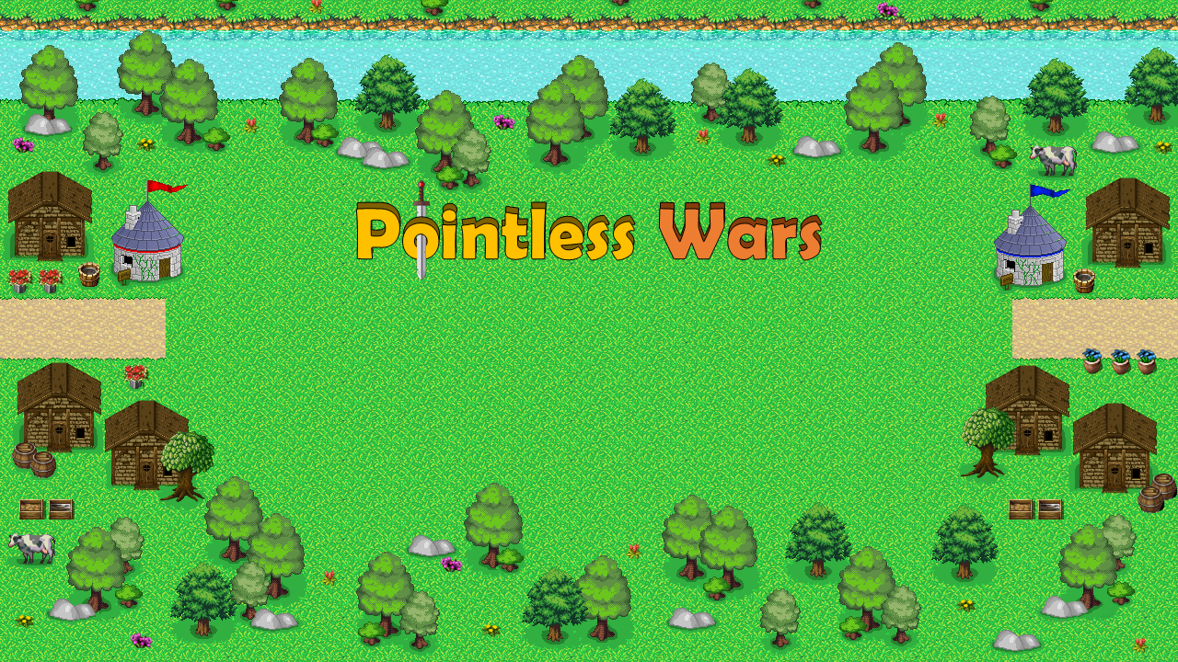

Slide 27
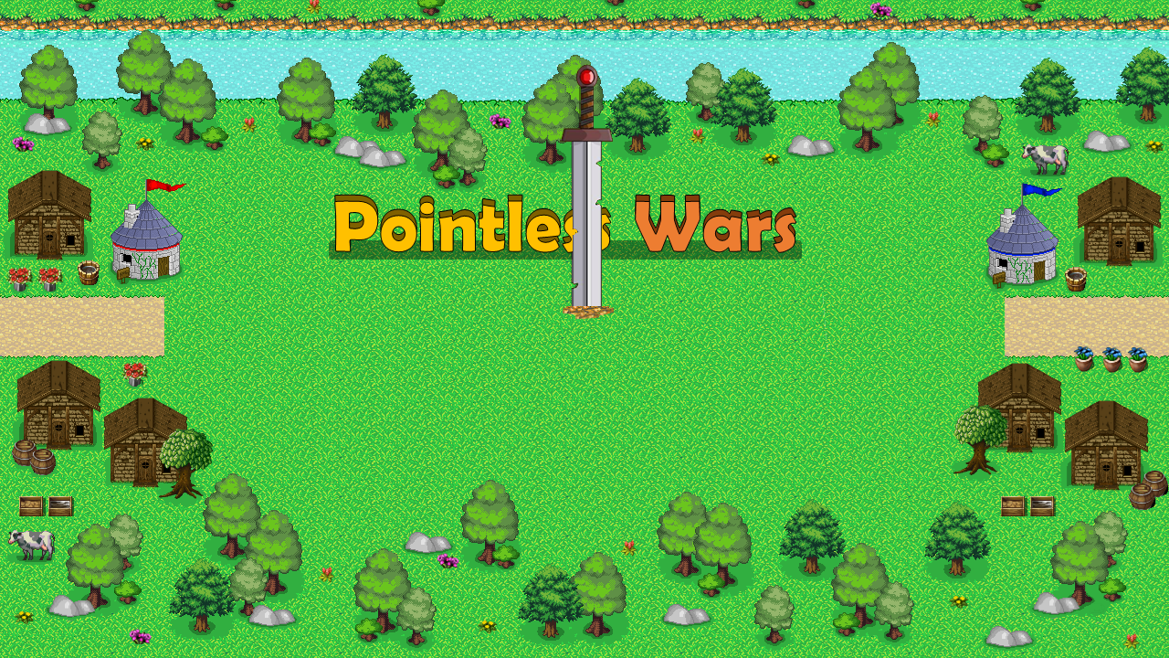

Slide 28
Pointless Wars
Pointless Wars
Pointless Wars
Pointless Wars

Slide 29
Pointless Wars
Pointless Wars
Pointless Wars
Pointless Wars

Slide 30
Pointless Wars
Pointless Wars
Pointless Wars
Pointless Wars
Pointless Wars

Slide 31
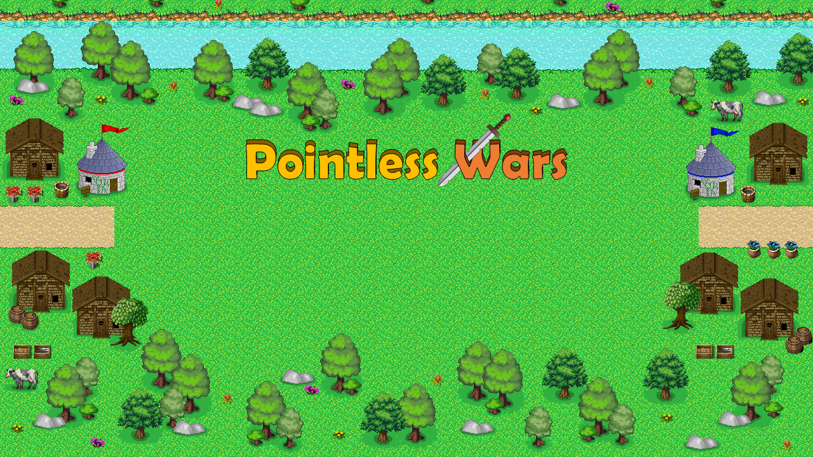

Slide 32


Slide 33
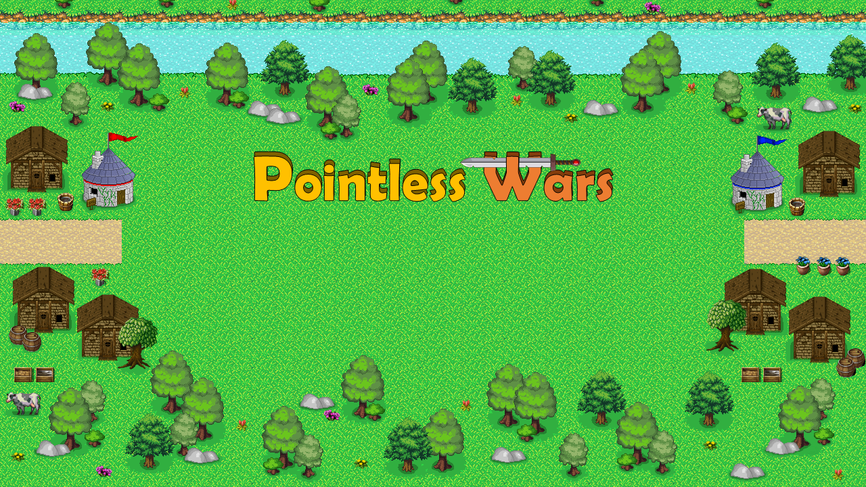

Slide 34
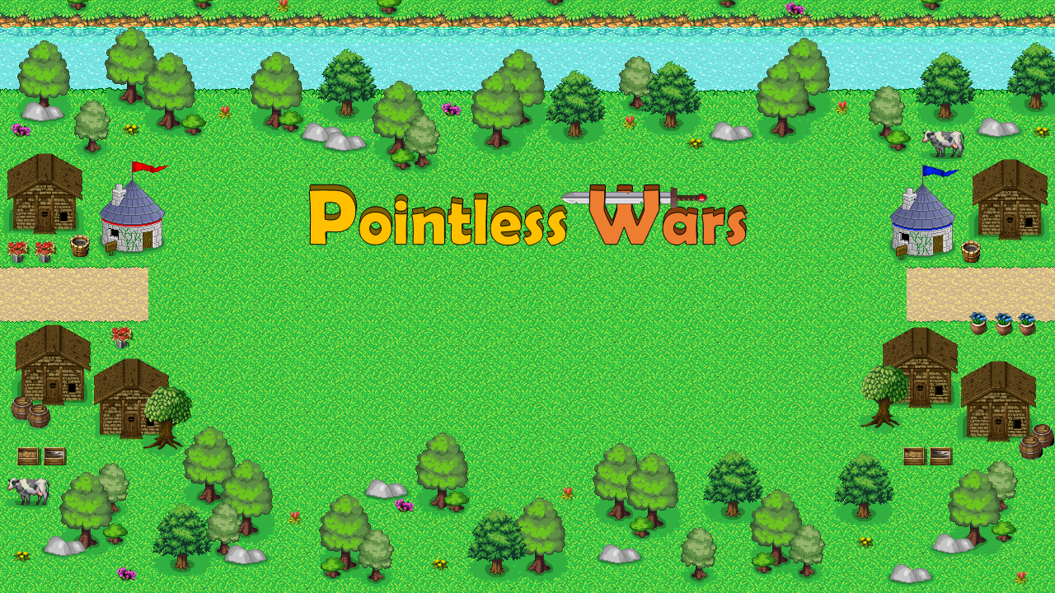
W

Slide 35
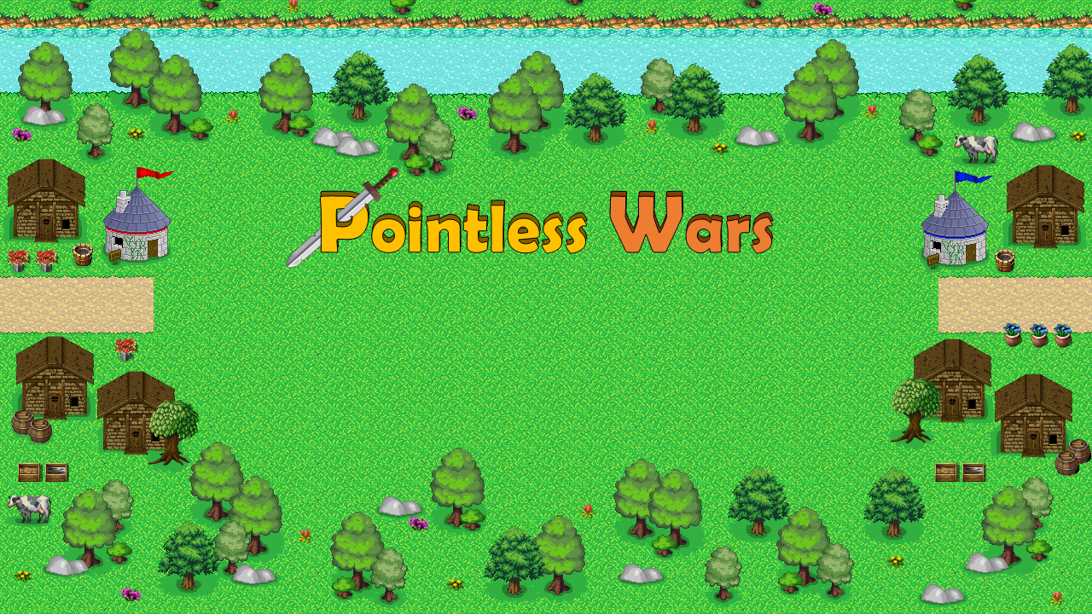

Slide 36
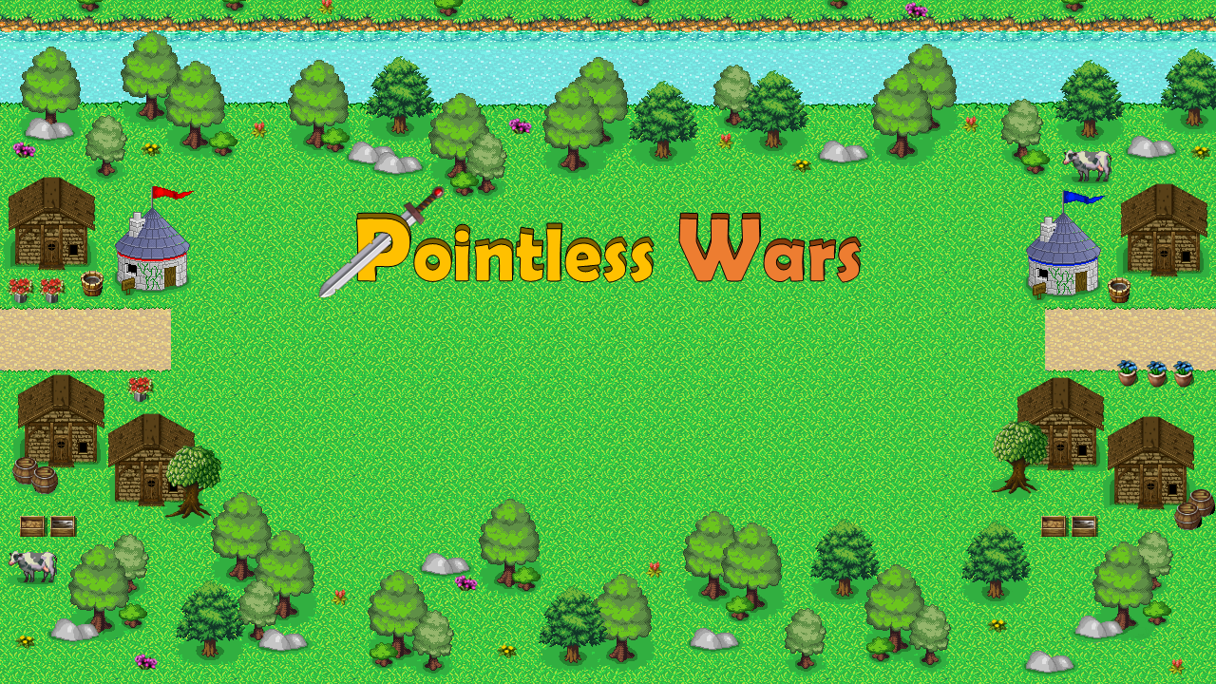

Slide 37
Pointless Wars
Pointless Wars

Slide 38


Slide 39


Slide 41


Slide 44


Slide 45


Slide 46




Slide 48


